Slide 1
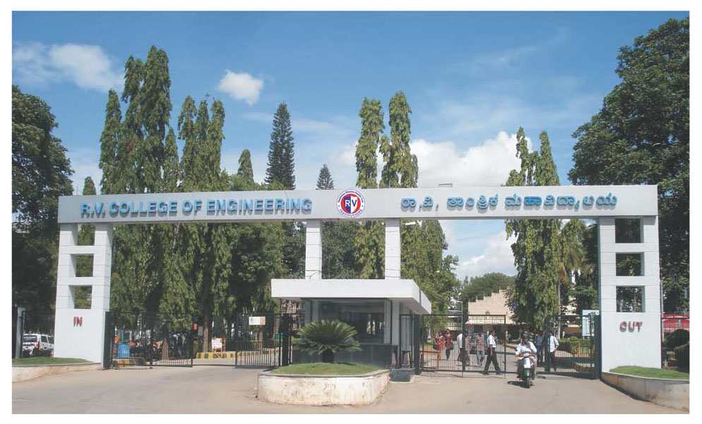
Dept. of CSE, RVCE

Slide 2
Presentation Outline
Discrete Mathematical Structures
Course Title
CS241AT
Course Code
Dept.of CSE
Host Dept

Slide 3
Course Contents & Availability of study material
UNIT-IV
Matchings and Factors: Min-Max theorem, Independent sets and covers, Dominating sets, maximum bipartite matching.
Coloring of graphs: The chromatic number of a graph, Results for general graphs, The chromatic polynomial of a graph, Basic properties of chromatic polynomial, chordal graphs, powers of graphs, Edge coloring of graphs.
UNIT-V
Graph algorithms: Graph connectivity algorithms, Breadth first search and Depth first search, Shortest path algorithms, Dijikstra’s shortest path algorithm, Minimum cost spanning tree algorithms, Algorithm of Kruskal’s and Prim’s.

Slide 4
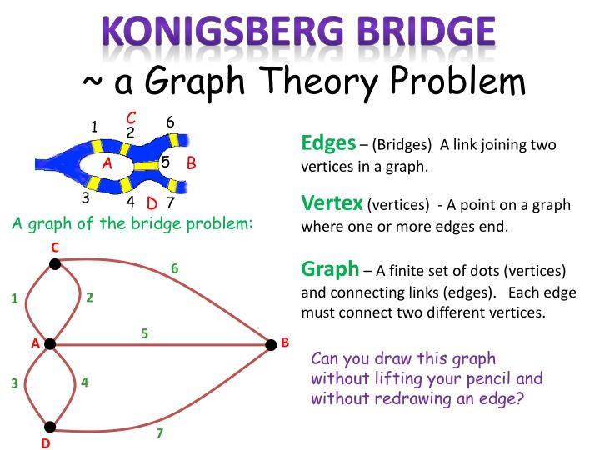

Slide 5
UNIT-I
The key to Euler’s solution was in a very simple abstraction of the puzzle. Let us redraw our diagram of the city of K ̈onigsberg by representing each of the land masses as a vertex and representing each bridge as an edge connecting the vertices corresponding to the land masses. We now have a graph that encodes the necessary information. The problem reduces to finding a ”closed walk” in the graph which traverses each edge exactly once, this is called an Eulerian circuit. Does such a circuit exist?

Slide 6
UNIT-I
Definition 1. A graph is an ordered triple (V(G), E(G),IG), where V(G) is a nonempty set ,E(G) is a set disjoint from V(G) , and IG is an “incidence ”relation that associates with each element of E(G) an unordered pair of elements(same or distinct) of V(G). Elements of V(G) are called the vertices (or nodes or points) of G, and elements of E(G) are called the edges (or lines) of G. V(G) and E(G) are the vertex set and edge set of G, respectively. If, for the edge e of G, IG(e)={u, v}, we write IG(e)=uv.
Example 1. If V(G)={v1, v2, v3, v4, v5}, E(G)={e1, e2, e3, e4, e5, e6} and IG is given by IG(e1)={v1, v5}, IG(e2)={v2, v3), IG(e3)={v2, v4}, IG(e4)={v2, v5)}, IG(e5)={v2, v5}, IG(e6)={v3, v3}, then (V(G), E(G), IG) is a graph.
Diagrammatic Representation of a Graph. Each graph can be represented by a diagram in the plane. In this diagram, each vertex of the graph is represented by a point, with distinct vertices being represented by distinct points. Each edge is represented by a simple “Jordan” arc joining two (not necessarily distinct) vertices. The diagrammatic representation of a graph aids in visualizing many concepts related to graphs and the systems of which they are models. In a diagrammatic representation of a graph, it is possible that two edges intersect at a point that is not necessarily a vertex of the graph.

Slide 7
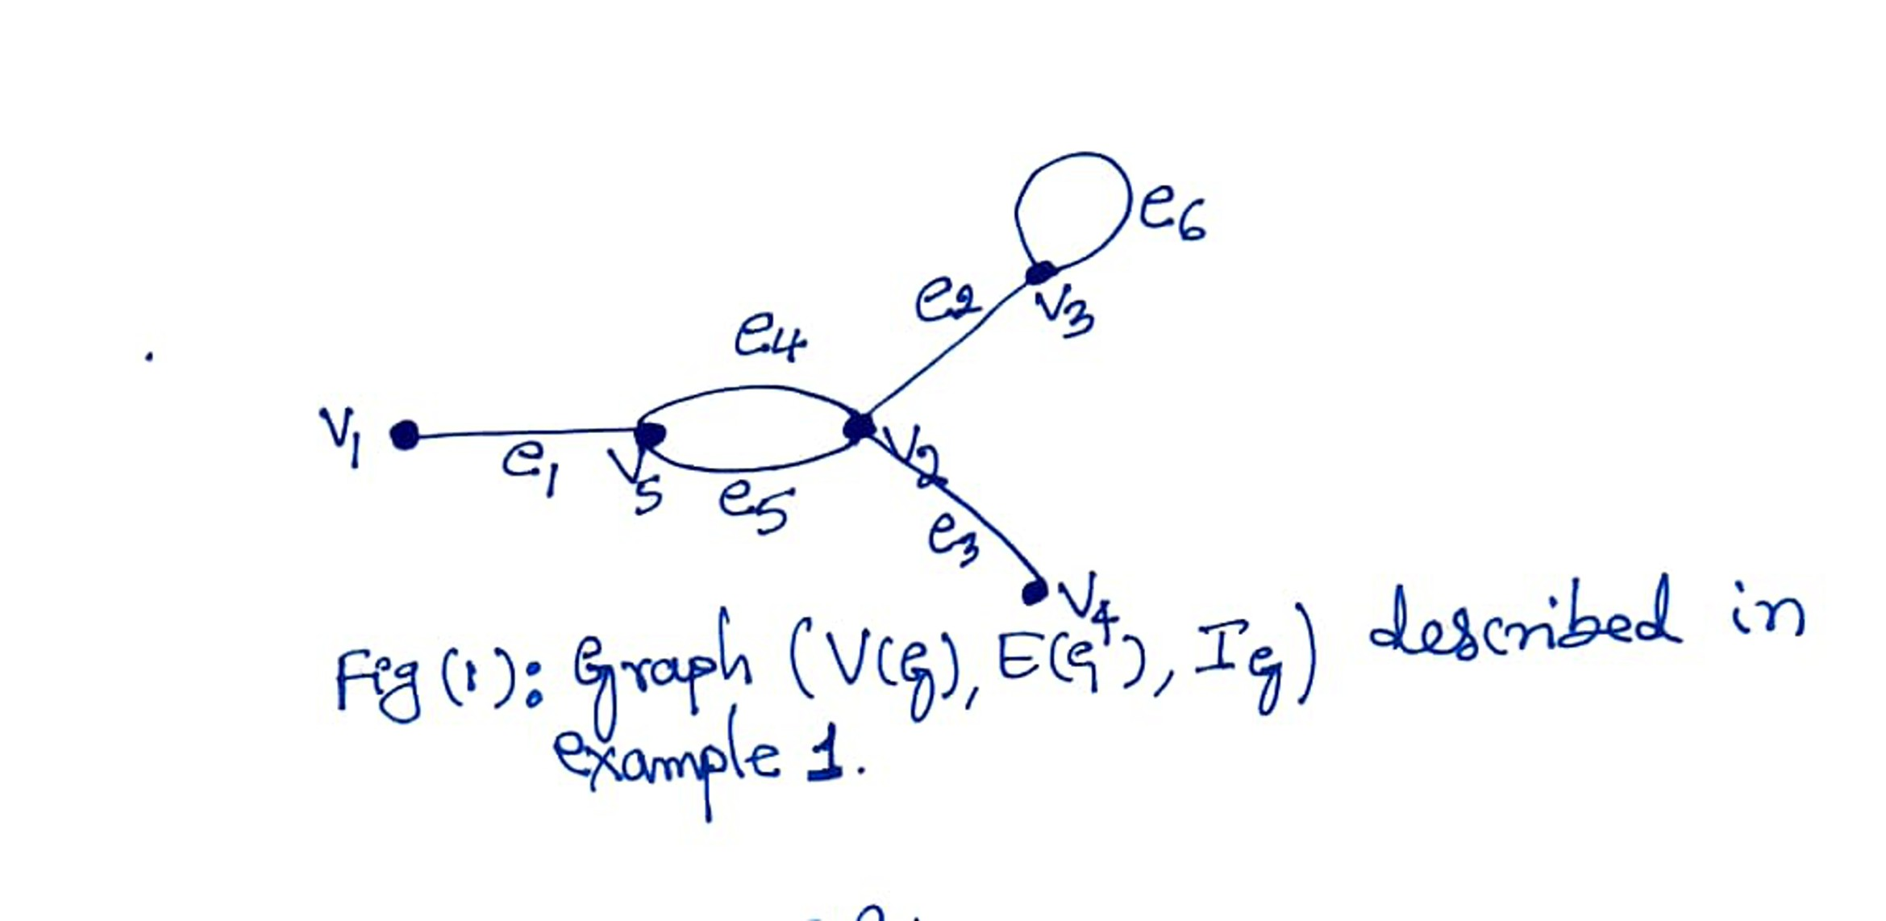
UNIT-I
Example 2. In the graph of Fig.1., edge e₃ =v₂v_{4,} edges e₄ and e₅ form multiple edges, e₆ is a loop at v_{3,}
N(v₂)= {v_{3,} v_{4,} v₅ }, N(v₃) = {v_{2}}}, N[v₂ ]= {v₂,v₃, v₄,v₅}, and N[v₂ ]= N(v₂) U {v₂}. Further, v₂ and v₅ are adjacent vertices and e₃ and e₄ are adjacent edges.
Definition 3. A graph is called finite if both V(G) and E(G) are finite. A graph that is not finite is called an infinite graph. Unless otherwise stated, all graphs considered in this course are finite. Throughout the course, we denote by n(G) and m(G) the number of vertices and edges of the graph G respectively. The number n(G) is called the order of G and m(G) is the size of G. When explicit reference to the graph G is not needed, V(G), E(G), n(G), and m(G) will be denoted simply by V, E, n, and m respectively.

Slide 8
UNIT-I
Definition 2. If I_{G} (e)={u,v}, then the vertices u and v are called the end vertices or ends of the edge e.
Each edge is said to join its ends, in this case, we say that e is incident with each one of its ends. Also, the vertices u and v are then incident with e.
A set of two or more edges of a graph G is called a set of multiple or parallel edges if they have the same pair of distinct ends. If e is an edge with end vertices u and v, we write e= uv.
An edge for which the two ends are the same is called a loop at the common vertex.
A vertex u is a neighbor of v in G, if uv is an edge of G, and u ≠ v. The set of all neighbors of v is the open neighborhood of v or the neighbor set of v, and is denoted by N(v), the set N[v]= N(v) U {v} is the closed neighborhood of v in G.
Vertices u and v are adjacent to each other in G if and only if there is an edge of G with u and v as its ends. Two distinct edges e and f are said to be adjacent if and only if they have a common end vertex.
A graph is simple if it has no loops and no multiple edges. Thus, for a simple graph G, the incidence function I_{G} is one-to-one. Hence, an edge of a simple graph is identified with the pair of its ends. A simple graph therefore may be considered as an ordered pair (V(G), E(G)), where V(G) is a nonempty set and E(G) is a set of unordered pairs of elements of V(G) (each edge of the graph being identified with the pair of its ends).

Slide 9
UNIT-I
Example 2. In the graph of Fig(1), edge e₃ ₌ v₂v₄;, edges e₄ and e₅ form multiple edges, e₆ is a loop at v₃, N(v₂)={v₃,v₄,v₅},
N(v₃)= {v₂}, N[v₂ ]= {v₂,v₃,v₄,v₅} and N[v₂ ]= N(v₂ ) U {v₂}. Further, v₂ and v₅ are adjacent vertices and e₃ and e₄ are adjacent edges.
Definition 3. A graph is called finite if both V(G) and E(G) are finite. A graph that is not finite is called an infinite graph. Unless otherwise stated, all graphs considered are finite. Throughout this course, we denote by n(G) and m(G) the number of vertices and edges of the graph G, respectively. The number n(G) is called the order of G and m(G) is the size of G. When explicit reference to the graph G is not needed, V(G), E(G), n(G), and m(G) will be denoted simply by V, E, n, and m, respectively.
Figure (2) is a graph with loops and multiple edges, while Fig (3) represents a simple graph.
Definition 4. A graph is said to be labeled if its n vertices are distinguished from one another by labels such as v₁;v₂;:::;v_{n}
In Fig(4) the graph G is labeled and the graph H is not labeled.

Slide 10
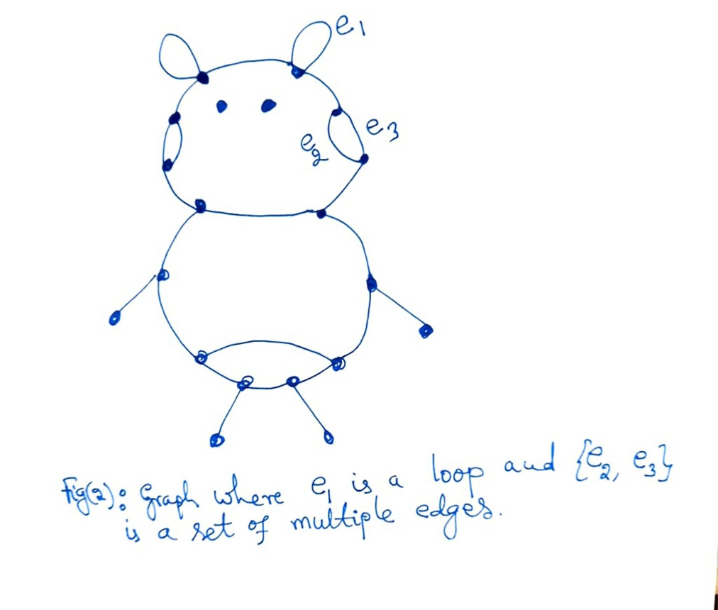
UNIT-I

Slide 11
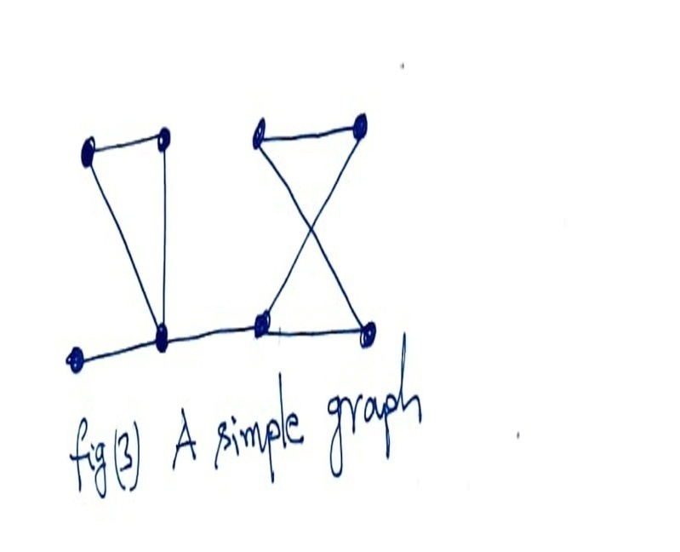
UNIT-I

Slide 12
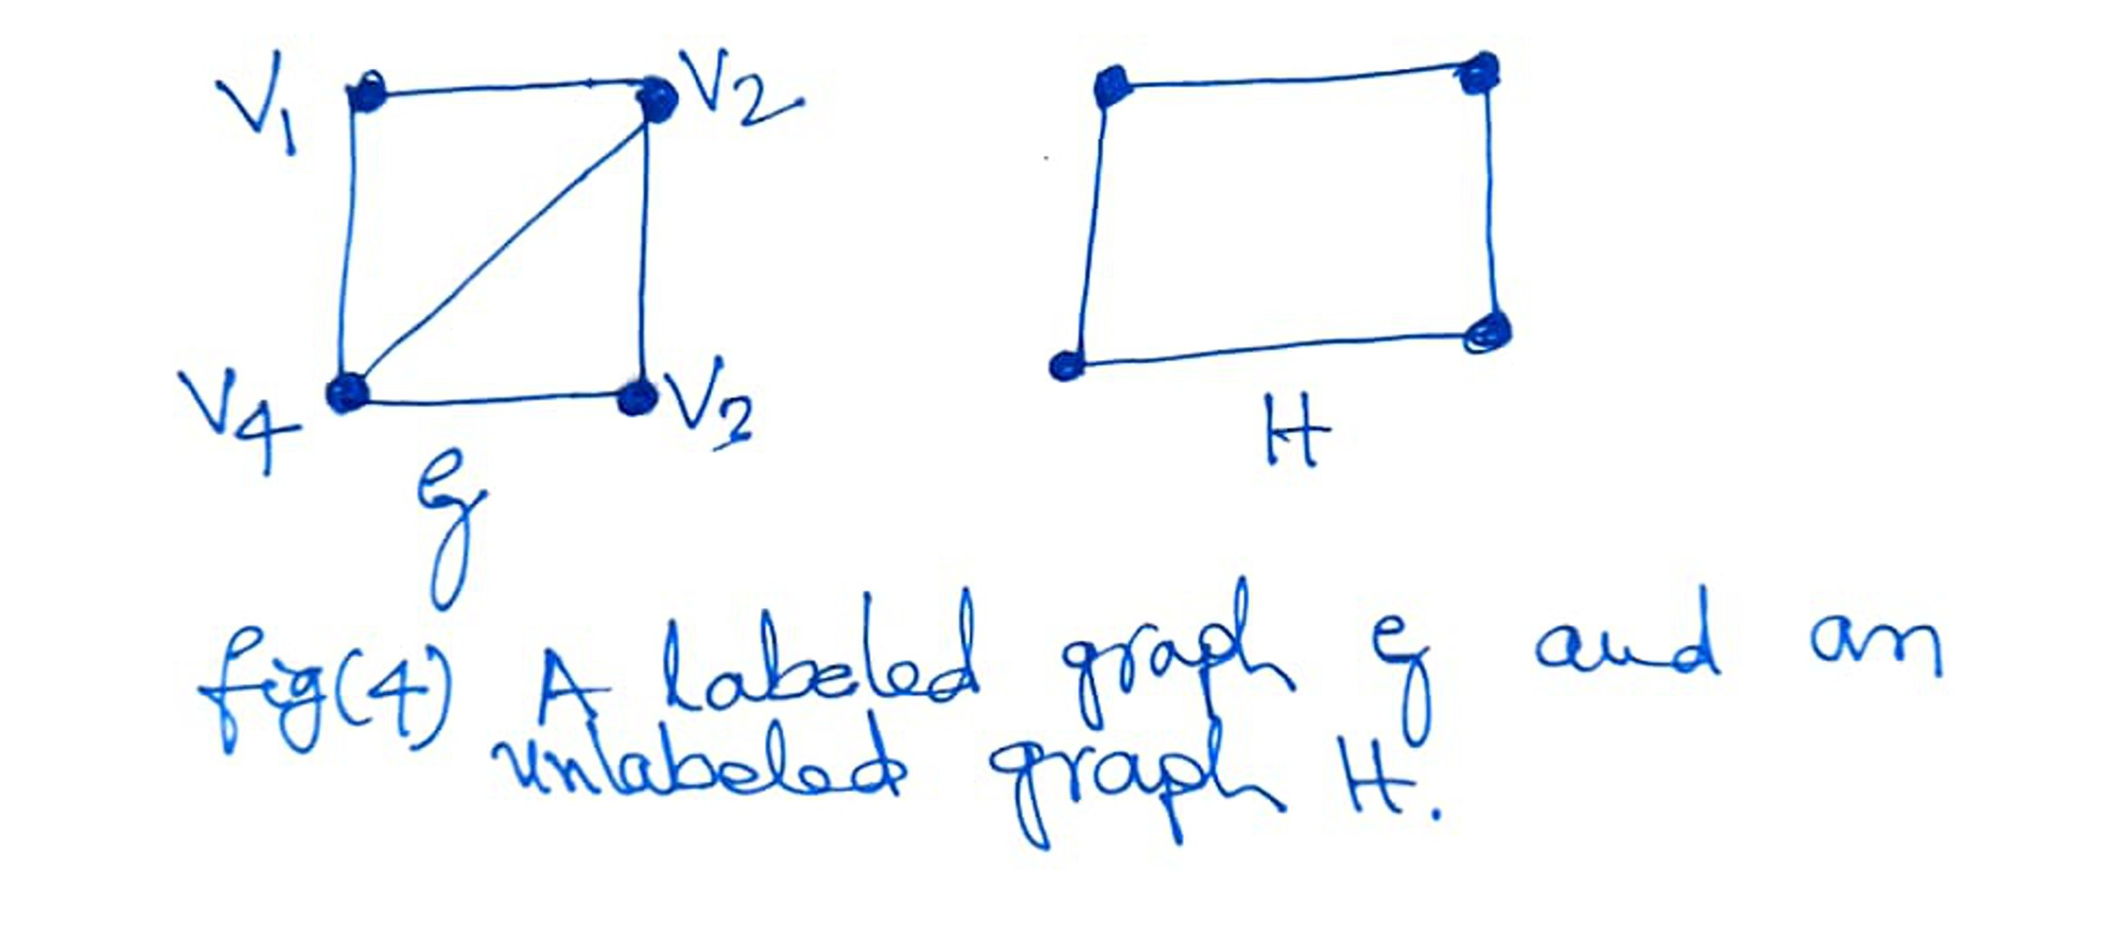
UNIT-I

Slide 13
UNIT-I
Graph Isomorphism: A graph can exist in different forms having the same number of vertices, edges, and also the same edge connectivity. Such graphs are called isomorphic graphs. Note that we label the graphs in this chapter mainly for the purpose of referring to them and recognizing them from one another.
Isomorphic Graphs
Two graphs G₁ and G₂ are said to be isomorphic if −
Their number of components (vertices and edges) are same.
Their edge connectivity is retained.
There exists a function ‘f’ from vertices of G₁ to vertices of G₂ [f: V(G₁) ⇒ V(G₂)], such that
Case (i): f is a bijection (both one-one and onto)
Case (ii): f preserves adjacency of vertices, i.e., if the edge {U, V} ∈ G₁, then the edge {f(U), f(V)} ∈ G₂, then G₁ ≡ G₂.
Note
If G₁ ≡ G₂ then −
|V(G₁)| = |V(G₂)|
|E(G₁)| = |E(G₂)|
Degree sequences of G₁ and G₂ are same.
If the vertices {V₁, V₂, .. Vk} form a cycle of length K in G₁, then the vertices {f(V₁), f(V₂),… f(Vk)} should form a cycle of length K in G₂.
All the above conditions are necessary for the graphs G₁ and G₂ to be isomorphic, but not sufficient to prove that the graphs are isomorphic.
(G₁ ≡ G₂) if and only if (G₁− ≡ G₂−) where G₁ and G₂ are simple graphs.
(G₁ ≡ G₂) if the adjacency matrices of G₁ and G₂ are same.
(G₁ ≡ G₂) if and only if the corresponding subgraphs of G₁ and G₂ (obtained by deleting some vertices in G1 and their images in graph G₂) are isomorphic.

Slide 14
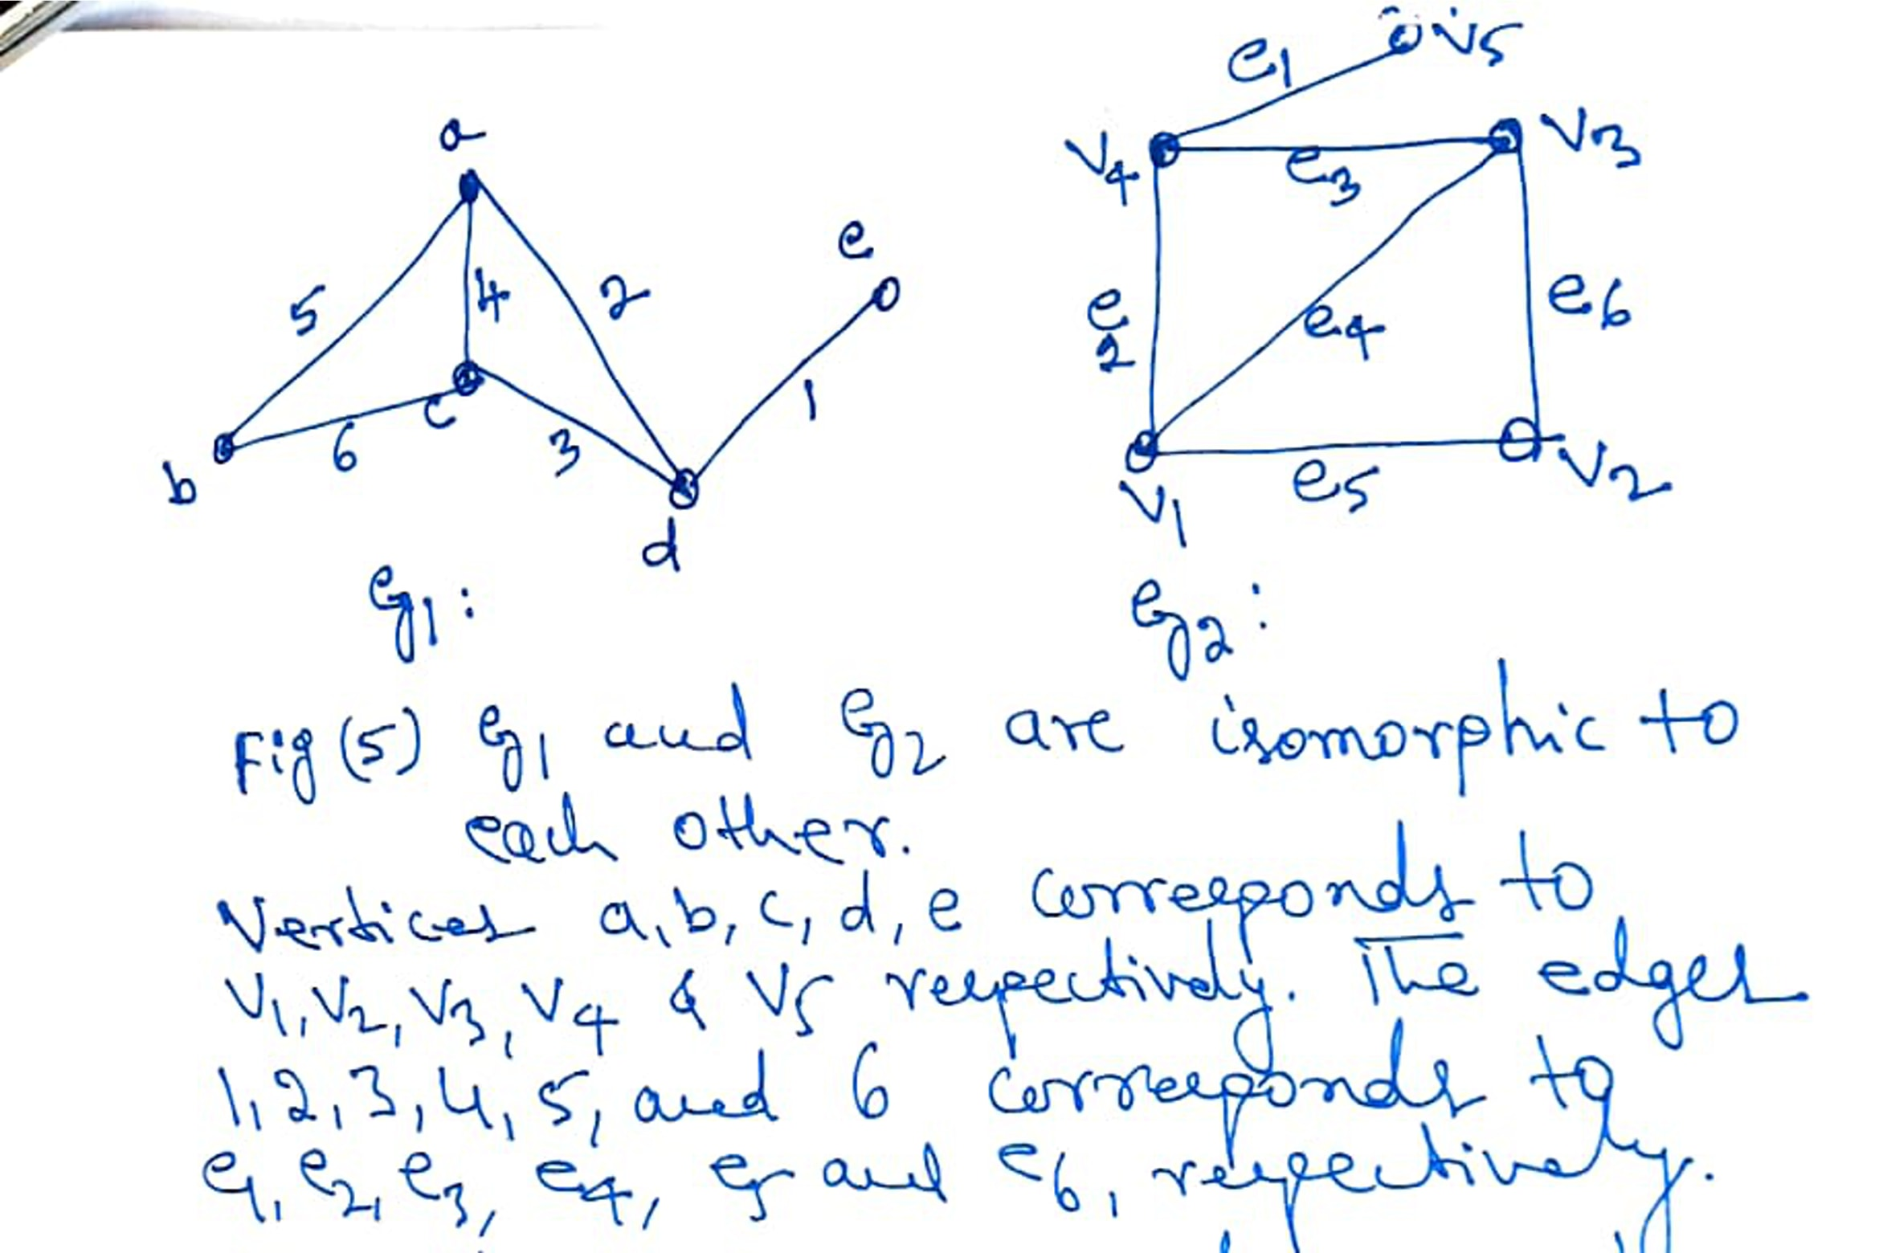
UNIT-I

Slide 15
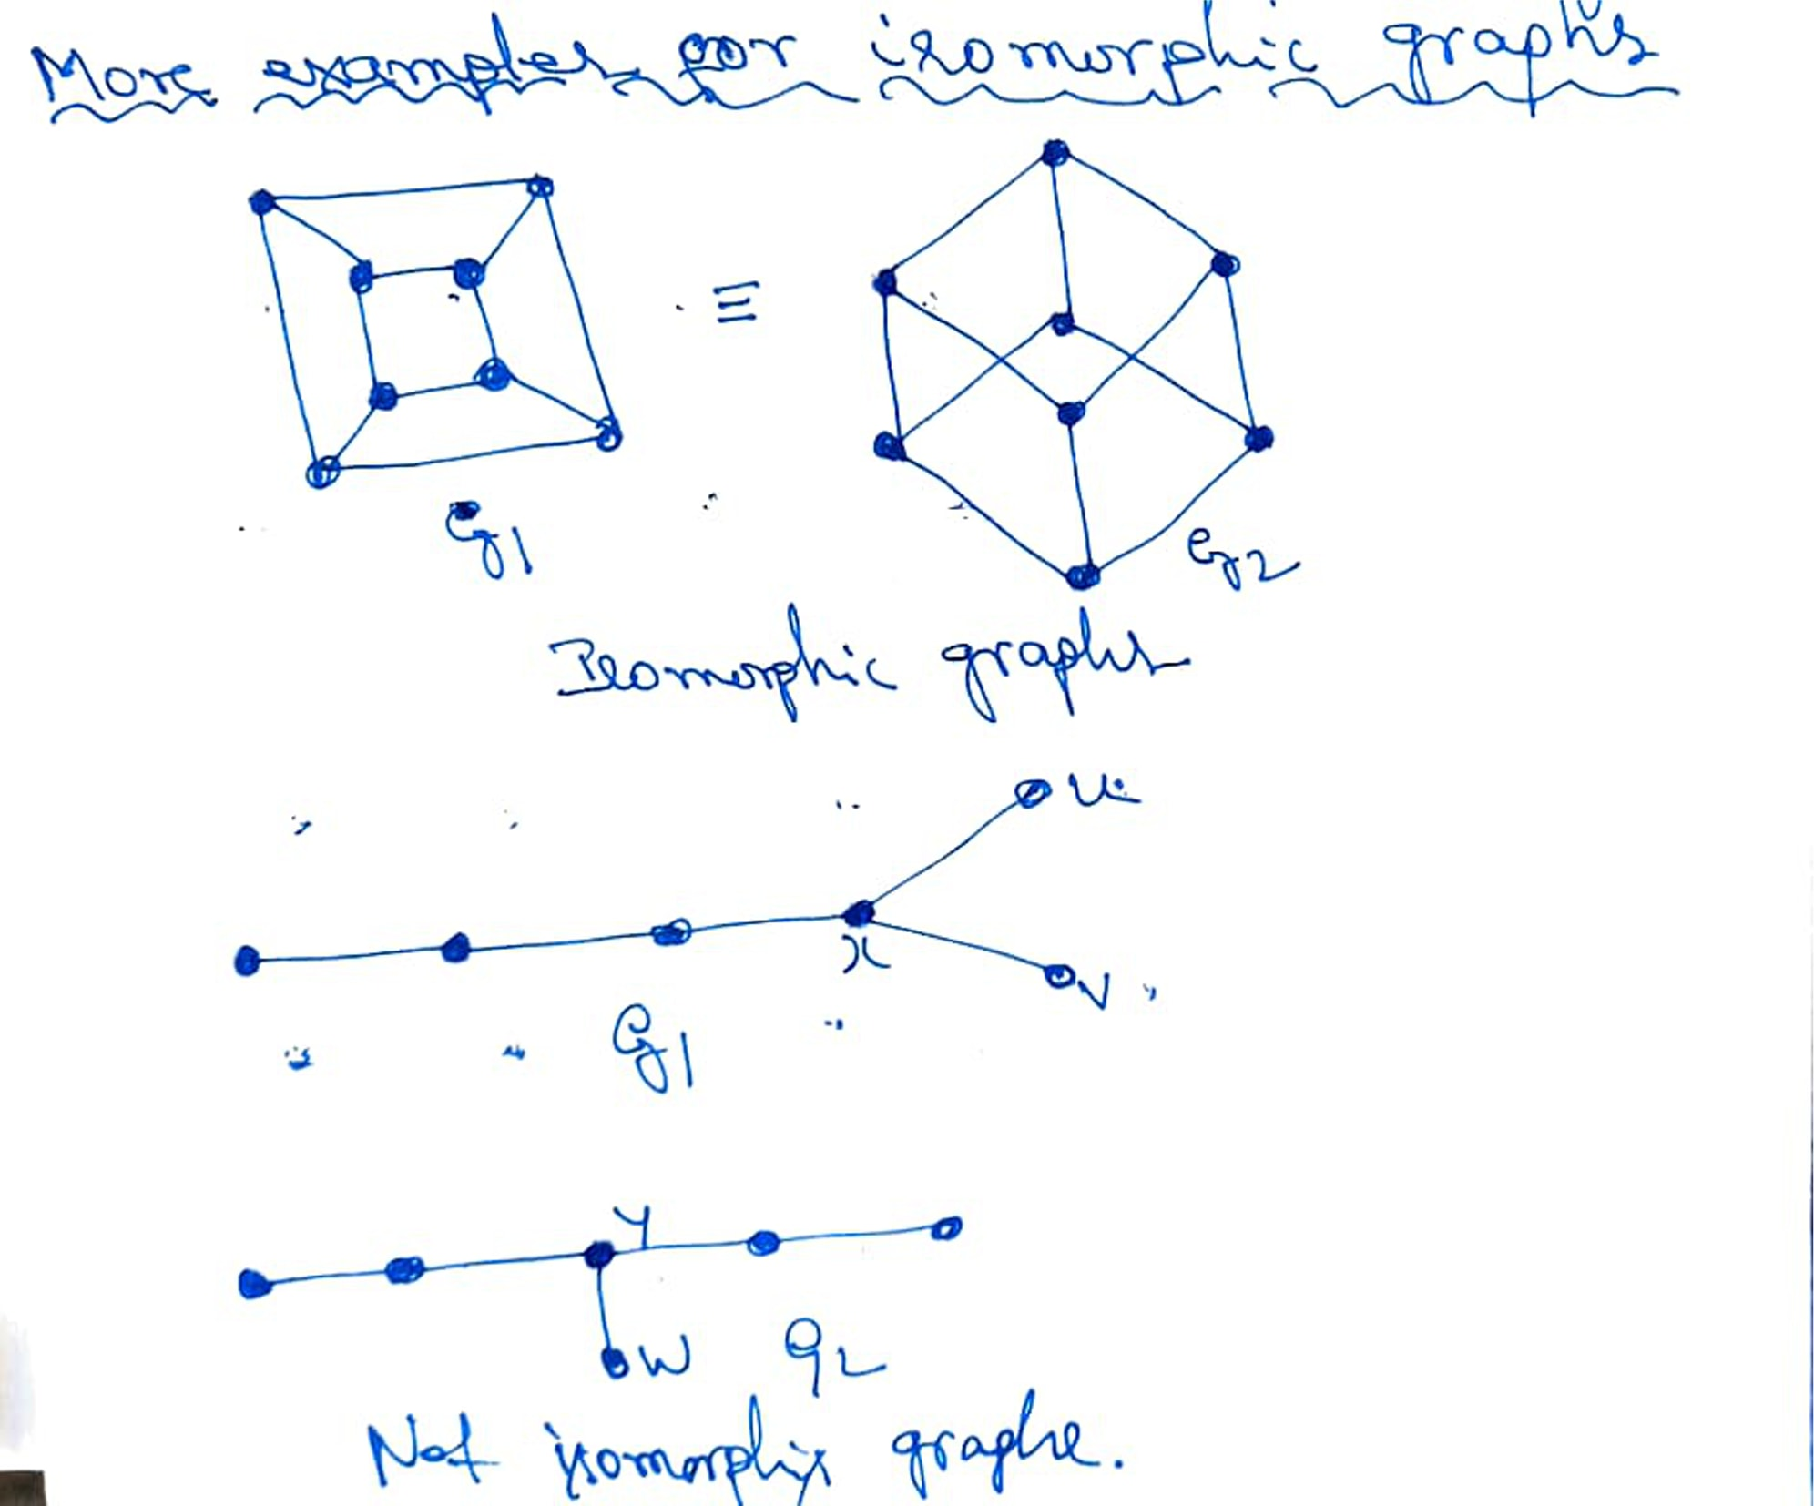
UNIT-I

Slide 16
UNIT-I
Fundamental Definitions
A cycle is a simple graph whose vertices can be cyclically ordered so that two vertices are adjacent if and only if they are consecutive in the cyclic ordering.
We usually think of paths and cycles as subgraphs within some larger graph. A subgraph H of a graph G, is a graph such that V (H) ⊆ V (G) and E(H) ⊆ E(G) satisfying the property that for every e ∈ E(H), where e has endpoints u, v ∈ V (G) in the graph G, then u, v ∈ V (H) and e has endpoints u, v in H, i.e. the edge relation in H is the same as in G.
A graph G is connected if for every u, v V (G) there exists a u, v-path in G. Otherwise G is called disconnected. The maximal connected subgraphs of G are called its components.
A walk is a list v₀, e₁, v₁, . . . , e_{k}, v_{k} of vertices and edges such that for 1 ≤ I ≤ k, the edge e_{i} has endpoints v_{i−1} and v_{i}.
A trail is a walk with no repeated edge. A u, v-walk or u, v-trail has first vertex u and last vertex v. When the first and last vertex of a walk or trail are the same, we say that they are closed. A closed trail is called a circuit.
A path is a simple graph whose vertices can be ordered so that two vertices are adjacent if and only if they are consecutive in the ordering. A path which begins at vertex u and ends at vertex v is called a u, v-path.

Slide 17
UNIT-I
With this new terminology, we can consider paths and cycles not just as subgraphs, but also as ordered lists of vertices and edges. From this point of view, a path is a trail with no repeated vertex, and a cycle is a closed trail (circuit) with no repeated vertex other than the first vertex equals the last vertex.
Alternatively, we could consider the sub graph traced out by a walk or trail.
(a) (b) (c) (d) (e) (f) (g) (h)
Which graphs are simple?
Suppose that for any graph, we decide to add a loop to one of the vertices. Does this affect whether or not the graph is Eulerian?
Which graphs are connected?
Which graphs are Eulerian? Trace out an Eulerian circuit or explain why an Eulerian circuit is not possible.
Are there any graphs above that are not Eulerian, but have an Eulerian trail?
Give necessary conditions for a graph to be Eulerian.
Give necessary conditions for a graph to have an Eulerian trail.

Slide 18
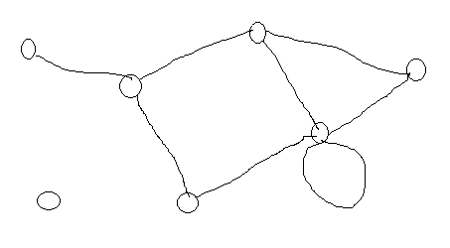
In graph theory, the degree (or valency) of a vertex of a graph is the number of edges that are incident to the vertex, and in a multigraph, loops are counted twice.^{[1]} The degree of a vertex is denoted deg(v).
The maximum degree of a graph, denoted by ∆(G), and the minimum degree of a graph, denoted by δ(G), are the maximum and minimum degree of its vertices.
In the graph gelow, the maximum degree is 5 and the minimum degree is 0.
In a regular graph, every vertex has the same degree, and so we can speak of the degree of the graph. A complete graph (denoted Kn , where n is the number of vertices in the graph) is a special kind of regular graph where all vertices have the maximum degree.
The degree sum formula states that, given a graph G=(V,E), ∑deg(v)=2|E|.
The formula implies that in any undirected graph, the number of vertices with odd degree is even. This statement (as well as the degree sum formula) is known as the handshaking lemma. The latter name comes from a popular mathematical problem, which is to prove that in any group of people, the number of people who have shaken hands with an odd number of other people from the group is even.

Slide 19
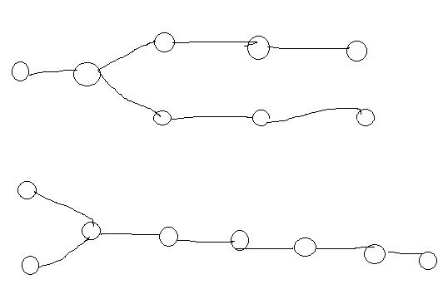
Degree sequence
The degree sequence of an undirected graph is the non-increasing sequence of its vertex degrees, for the below graph it is (5, 3, 3, 2, 2, 1, 0).
The degree sequence is a graph invariant so isomorphic graphs have the same degree sequence. However, the degree sequence does not, in general, uniquely identify a graph; in some cases, non-isomorphic graphs have the same degree sequence.
Two non-isomorphic graphs with the same degree sequence (3, 2, 2, 2, 2, 1, 1, 1).

Slide 20
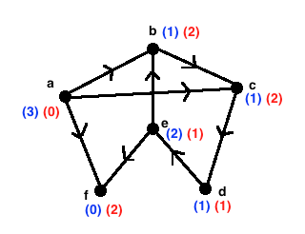
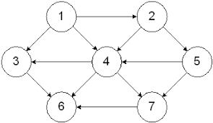
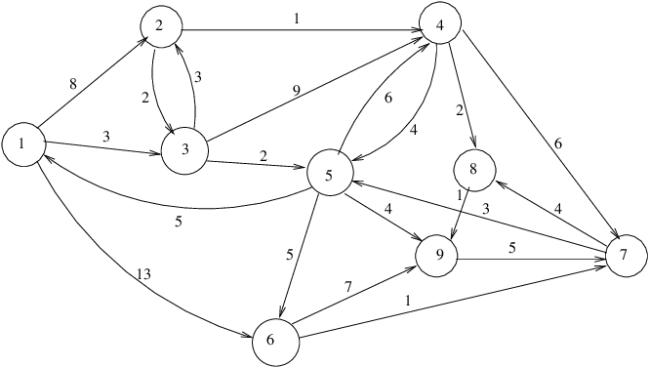
A directed graph is a set of vertices (nodes) connected by edges, with each node having a direction associated with it. In the example fig (1) below, the graph can be traversed from vertex a to b, but not from vertex b to a.
Indegree of a vertex is the number of edges entering in to that vertex.
Outdegree of a vertex is the number of edges leaving that vertex.

Slide 21
Definition: The degree of a vertex in an undirected graph is the number of edges incident with it, except that a loop at a vertex contributes twice to the degree of that vertex.
In other words, you can determine the degree of a vertex in a displayed graph by counting the lines that touch it.
The degree of the vertex v is denoted by deg(v).
A vertex of degree 0 is called isolated, since it is not adjacent to any vertex.
Note: A vertex with a loop at it has at least degree 2 and, by definition, is not isolated, even if it is not adjacent to any other vertex.
A vertex of degree 1 is called pendant. It is adjacent to exactly one other vertex.

Slide 22
Example: Which vertices in the following graph are isolated, which are pendant, and what is the maximum degree? What type of graph is it?
i
h
d
a
e
g
b
c
f
j
Solution: Vertex f is isolated, and vertices a, d and j are pendant. The maximum degree is deg(g) = 5. This graph is a pseudograph (undirected, loops).

Slide 23
Let us look at the same graph again and determine the number of its edges and the sum of the degrees of all its vertices:
i
h
d
a
e
g
b
c
f
j
Result: There are 9 edges, and the sum of all degrees is 18. This is easy to explain: Each new edge increases the sum of degrees by exactly two.

Slide 24
The Handshaking Theorem: Let G = (V, E) be an undirected graph with e edges. Then
2e = ∑_{v∈V} deg(v)
Example: How many edges are there in a graph with 10 vertices, each of degree 6?
Solution: The sum of the degrees of the vertices is 6⋅10 = 60. According to the Handshaking Theorem, it follows that 2e = 60, so there are 30 edges.

Slide 25
Theorem: An undirected graph has an even number of vertices of odd degree.
Proof: Let V1 and V2 be the set of vertices of even and odd degrees, respectively (Thus V1 ∩ V2 = ∅, and V1 ∪V2 = V).
Then by Handshaking theorem
2|E| = ∑_{v∈V} deg(v) = ∑_{v∈V1} deg(v) + ∑_{v∈V2} deg(v)
Since both 2|E| and ∑_{v∈V1} deg(v) are even,
∑_{v∈V2} deg(v) must be even.
Since deg(v) if odd for all v∈V2, |V2| must be even.

Slide 26
Definition: When (u, v) is an edge of the graph G with directed edges, u is said to be adjacent to v, and v is said to be adjacent from u.
The vertex u is called the initial vertex of (u, v), and v is called the terminal vertex of (u, v).
The initial vertex and terminal vertex of a loop are the same.

Slide 27
Definition: In a graph with directed edges, the in-degree of a vertex v, denoted by deg⁻(v), is the number of edges with v as their terminal vertex.
The out-degree of v, denoted by deg⁺(v), is the number of edges with v as their initial vertex.
Question: How does adding a loop to a vertex change the in-degree and out-degree of that vertex?
Answer: It increases both the in-degree and the out-degree by one.

Slide 28
Example: What are the in-degrees and out-degrees of the vertices a, b, c, d in this graph:
deg⁻(b) = 4
deg⁺(b) = 2
deg⁻(a) = 1
deg⁺(a) = 2
a
b
deg⁻(d) = 2
deg⁺(d) = 1
deg⁻(c) = 0
deg⁺(c) = 2
d
c

Slide 29
Theorem: Let G = (V, E) be a graph with directed edges. Then:
∑_{v∈V} deg⁻(v) = ∑_{v∈V} deg⁺(v) = |E|
This is easy to see, because every new edge increases both the sum of in-degrees and the sum of out-degrees by one.

Slide 30
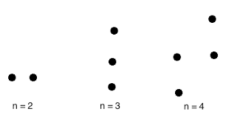
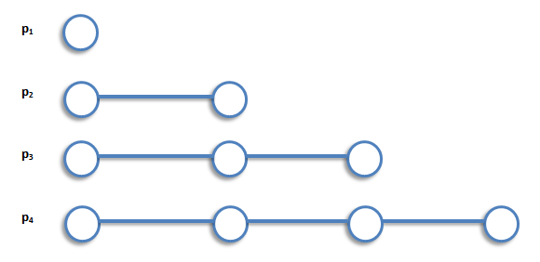
Special Graphs
Definition: The Null graph on n vertices is the simple graph that contains exactly n vertices and no edges.
Example:
Definition: The Path graph or linear graph is a graph whose vertices can be listed in the order v₁, v₂, …, vₙ such that the edges are {vᵢ, vᵢ₊₁} where i = 1, 2, …, n − 1. The Path graph on n vertices is denoted by Pn.
Example:

Slide 31
Special Graphs
Definition: The complete graph on n vertices, denoted by K_{n}, is the simple graph that contains exactly one edge between each pair of distinct vertices.
K₁
K₂
K₃
K₄
K₅

Slide 32
Special Graphs
Definition: The cycle C_{n}, n ≥ 3, consists of n vertices v₁, v₂, …, v_{n} and edges {v₁, v₂}, {v₂, v₃}, …, {v_{n-1}, v_{n}}, {v_{n}, v₁}.
C₃
C₄
C₅
C₆

Slide 33
Special Graphs
Definition: We obtain the wheel W_{n} when we add an additional vertex to the cycle C_{n}, for n ≥ 3, and connect this new vertex to each of the n vertices in C_{n} by adding new edges.
W₃
W₄
W₅
W₆

Slide 34
Special Graphs
Definition: The n-cube, denoted by Q_{n}, is the graph that has vertices representing the 2^{n} bit strings of length n. Two vertices are adjacent if and only if the bit strings that they represent differ in exactly one bit position.
110
111
10
11
100
101
010
011
0
1
00
01
000
001
Q₁
Q₂
Q₃

Slide 35
Special Graphs
Definition: A simple graph is called bipartite if its vertex set V can be partitioned into two disjoint nonempty sets V₁ and V₂ such that every edge in the graph connects a vertex in V₁ with a vertex in V₂ (so that no edge in G connects either two vertices in V₁ or two vertices in V₂).
For example, consider a graph that represents each person in a village by a vertex and each marriage by an edge.
This graph is bipartite, because each edge connects a vertex in the subset of males with a vertex in the subset of females (if we think of traditional marriages).

Slide 36
Special Graphs
Example I: Is C₃ bipartite?
v₁
No, because there is no way to partition the vertices into two sets so that there are no edges with both endpoints in the same set.
v₂
v₃
Example II: Is C₆ bipartite?
v₁
v₁
v₆
v₆
Yes, because we can display C₆ like this:
v₂
v₅
v₂
v₅
v₃
v₄
v₃
v₄

Slide 37
Special Graphs
Definition: The complete bipartite graph K_{m,n} is the graph that has its vertex set partitioned into two subsets of m and n vertices, respectively. Two vertices are connected if and only if they are in different subsets.
K_{3,2}
K_{3,4}

Slide 38
Operations on Graphs
Definition: A subgraph of a graph G = (V, E) is a graph H = (W, F) where W⊆V and F⊆E.
Note: Of course, H is a valid graph, so we cannot remove any endpoints of remaining edges when creating H.
Example:
K₅
subgraph of K₅

Slide 39
Operations on Graphs
Definition: The union of two simple graphs G₁ = (V₁, E₁) and G₂ = (V₂, E₂) is the simple graph with vertex set V₁ ∪ V₂ and edge set E₁ ∪ E₂.
Example 1:The union of G₁ and G₂ is denoted by G₁ ∪ G₂.
G₁
G₂
G₁ ∪ G₂ = K₅

Slide 40
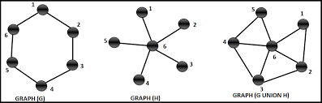
Operations on Graphs
Example 2: The union of G and H is denoted by G ∪ H.

Slide 41
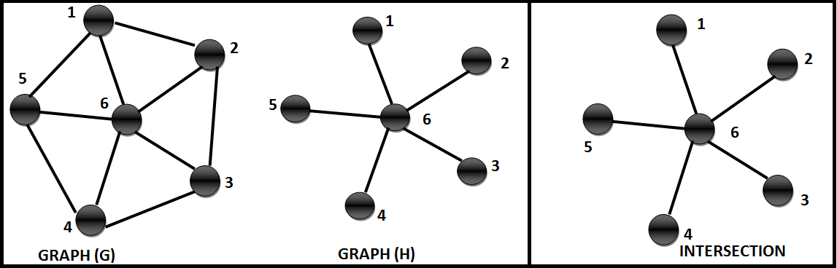
Operations on Graphs
Definition: The Intersection of two simple graphs G₁ =(V₁, E₁) and G₂ = (V₂, E₂) is the simple graph with vertex set V₁ ∩ V₂ and edge set E₁ ∩ E₂.
Example : The Intersection of G and H is denoted by G ∩ H.

Slide 42
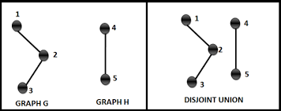
Operations on Graphs
Definition: The Disjoint Union of two or more simple graphs G₁ =(V₁, E₁) and G₂ = (V₂, E₂) is the simple graph with vertex set V₁ U V₂ and edge set E₁ U E₂, and V₁ ∩ V₂ =Ø and edge set E₁ ∩ E₂= Ø.
Example:

Slide 43
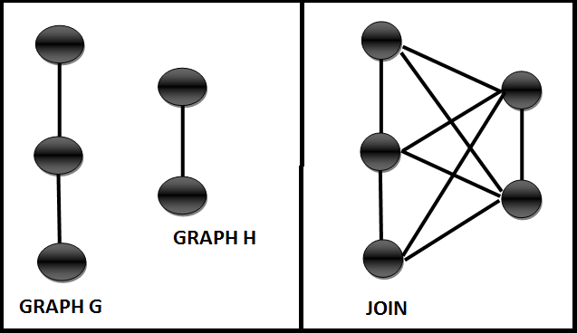
Operations on Graphs
Definition: The Join of two simple graphs G₁ =(V₁, E₁) and G₂ = (V₂, E₂) is the simple graph with vertex set V₁ U V₂ and edge set E₁ U E₂, and from each vertex belongs to V₁ add an edge to each vertex belongs to V₂.
Example:

Slide 44
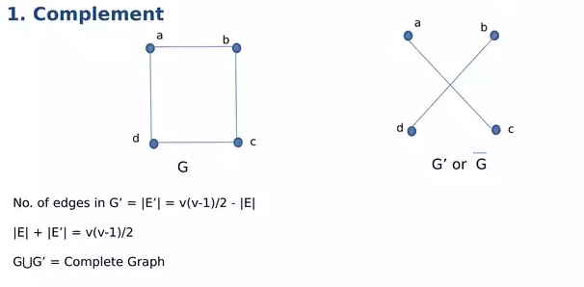
Operations on Graphs
Definition: The Complement of a graph G =(V, E) is a G₂ = (V₂, E₂) such that V₂ =V and E₂ contains all the edges which are not in G.
Example:

Slide 45
Deﬁnitions:
A graph H is called a sub graph of G if V(H) ⊆ V(G) and E(H) ⊆ E(G).
If H is a sub graph of G, then G is said to be a super graph of H.
A sub graph H of a graph G is a proper sub graph of G if either V(H) ≠V(G) or E(H) ≠ E(G).
A sub graph H of G is said to be an induced sub graph of G if each edge of G having its ends in V(H) is also an edge of H.
A sub graph H of G is a spanning sub graph of G if V(H)= V(G).

Slide 47

Graph representations

Slide 48
Graph representations
edge list: an unordered list of all edges in the graph
2
1
3
1
1
1
2
2
3
5
5
5
7
7
2
5
6
7
3
4
6
7
4
4
4
6
5

Slide 49
Graph representations
Edge List: Pros and Cons
advantages
easy to loop/iterate over all edges
disadvantages
hard to tell if an edge exists from A to B
hard to tell how many edges a vertex touches (its degree)
1
1
1
2
2
3
5
5
5
7
2
5
6
7
3
4
6
7
4
4

Slide 50
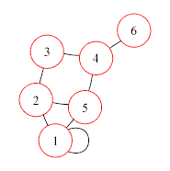
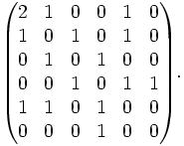
Graph representations
Adjacency Matrix
adjacency matrix: an n × n matrix where:
the nondiagonal entry a_{ij} is the number of edges joining vertex i and vertex j (or the weight of the edge joining vertex i and vertex j)
the diagonal entry a_{ii} corresponds to the number of loops (self-connecting edges) at vertex i

Slide 51
Graph representations
Adjacency Matrix: Pros and Cons
advantages
fast to tell whether edge exists between any two vertices i and j (and to get its weight)
disadvantages
consumes a lot of memory on sparse graphs (ones with few edges)
redundant information for undirected graphs

Slide 52
Graph representations
Adjacency Matrix Example
How do we figure out the degree of a given vertex?
How do we find out whether an edge exists from A to B?
How could we look for loops in the graph?
1 2 3 4 5 6 7
2
1
2
3
4
5
6
7
1
3
0
1
0
0
1
1
0
1
0
1
0
0
0
1
0
1
0
1
0
0
0
7
0
0
1
0
1
0
1
4
1
0
0
1
0
1
1
1
0
0
0
1
0
0
6
0
1
0
1
1
0
0
5

Slide 53
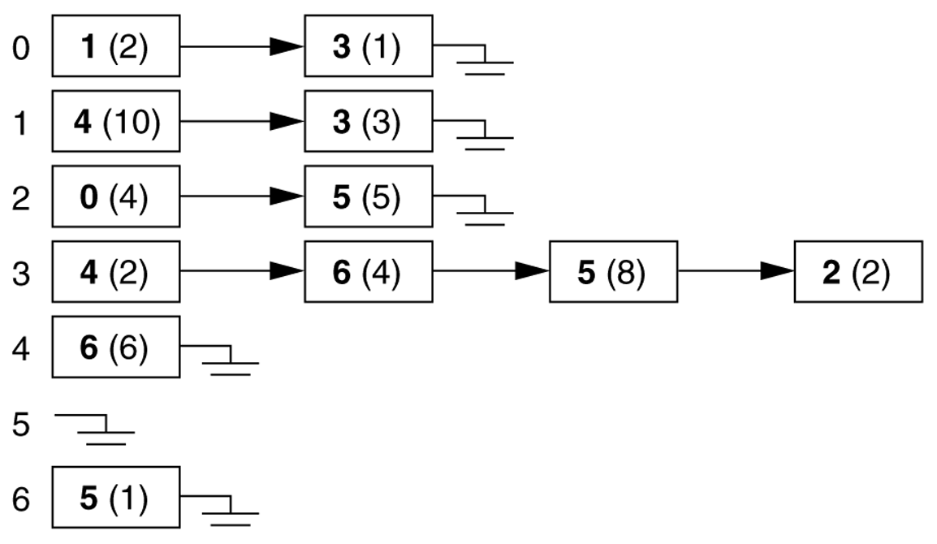
Graph representations
Adjacency Lists
adjacency list: stores edges as individual linked lists of references to each vertex's neighbors

Slide 54
Graph representations
Adjacency List: Pros and Cons
advantages:
new nodes can be added easily
new nodes can be connected with existing nodes easily
"who are my neighbors" easily answered
disadvantages:
determining whether an edge exists between two nodes: O(average degree)

Slide 55
Graph representations
Adjacency List Example
How do we figure out the degree of a given vertex?
How do we find out whether an edge exists from A to B?
How could we look for loops in the graph?
2
1
3
1
2
3
4
5
6
7
2
5
6
3
1
7
2
4
7
3
7
5
6
1
7
4
4
1
5
6
4
5
2
5

Slide 56
Graph representations
Runtime table
n vertices, m edges no parallel edges no self-loops | Edge List | Adjacency List | Adjacency Matrix
Space | n + m | n + m | n²
Finding all adjacent vertices to v | m | deg(v) | n
Determining if v is adjacent to w | m | deg(v) | 1
adding a vertex | 1 | 1 | n²
adding an edge to v | 1 | 1 | 1
removing vertex v | m | n? | n²
removing an edge from v | m | deg(v) | 1

Slide 57
Graph representations
Adjacency matrix for directed graph
Matrix[i][j] = 1 if (v_{i}, v_{j})∈E
0 if (v_{i}, v_{j})∉E
 |  | 1 | 2 | 3 | 4 | 5
 |  | v₁ | v₂ | v₃ | v₄ | v₅
1 | v₁ | 0 | 1 | 0 | 0 | 0
2 | v₂ | 0 | 0 | 0 | 1 | 0
3 | v₃ | 0 | 1 | 0 | 1 | 0
4 | v₄ | 0 | 0 | 0 | 0 | 0
5 | v₅ | 0 | 0 | 1 | 1 | 0
v₂
v₁
v₃
v₅
v₄
G

Slide 58
Graph representations
Adjacency list for directed graph
1 | v₁ | → | v₂
2 | v₂ | → | v₄
3 | v₃ | → | v₂ | → | v₄
4 | v₄
5 | v₅ | → | v₃ | → | v₄
v₂
v₁
v₃
v₅
v₄
G

Slide 59
Weighted graph
If each edge in G is assigned a weight, it is called a weighted graph
Chicago
New York
1000
3500
2000
Houston

Slide 60
Adjacency matrix for weighted undirected graph
Matrix[i][j] = w(v_{i}, v_{j}) if (v_{i}, v_{j})∈E or (v_{j}, v_{i})∈E
∞ otherwise
 |  | 1 | 2 | 3 | 4 | 5
 |  | v₁ | v₂ | v₃ | v₄ | v₅
1 | v₁ | ∞ | 5 | ∞ | ∞ | ∞
2 | v₂ | 5 | ∞ | 2 | 4 | ∞
3 | v₃ | 0 | 2 | ∞ | 3 | 7
4 | v₄ | ∞ | 4 | 3 | ∞ | 8
5 | v₅ | ∞ | ∞ | 7 | 8 | ∞
v₂
v₁
v₃
2
5
4
3
7
8
v₅
v₄
G

Slide 61
Graph representations
Adjacency list for weighted undirected graph
v₂
v₁
v₃
1 | v₁ | → | v₂(5)
2 | v₂ | → | v₁(5) | → | v₃(2) | → | v₄(4)
3 | v₃ | → | v₂(2) | → | v₄(3) | → | v₅(7)
4 | v₄ | → | v₂(4) | → | v₃(3) | → | v₅(8)
5 | v₅ | → | v₃(7) | → | v₄(8)
2
5
4
3
7
8
v₅
v₄
G

Slide 62
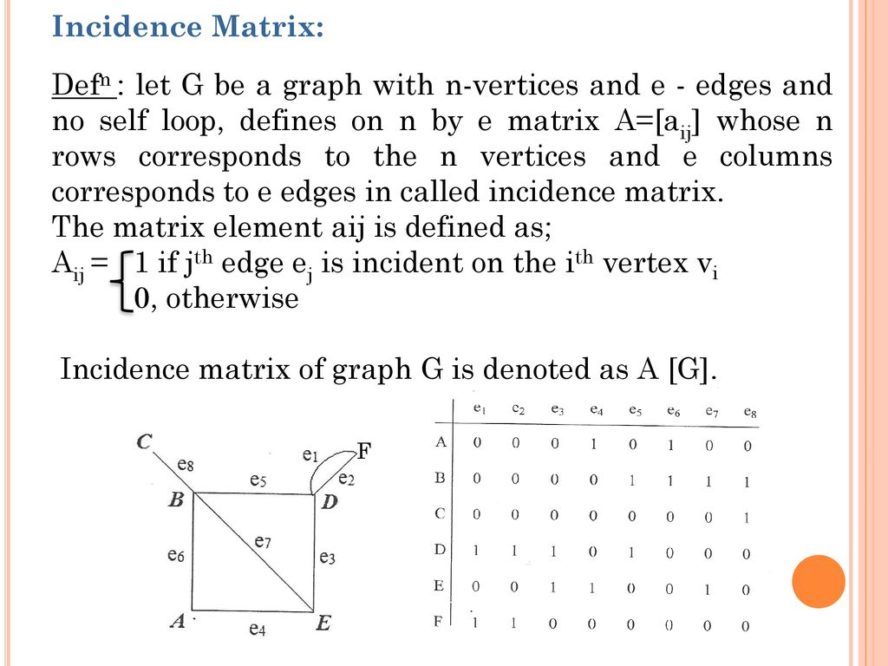
Graph representations

Slide 63
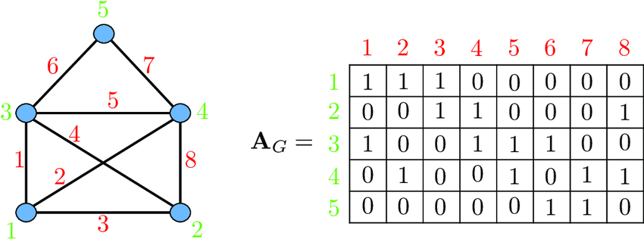
Graph representations
Incidence matrix for undirected graph

Slide 64
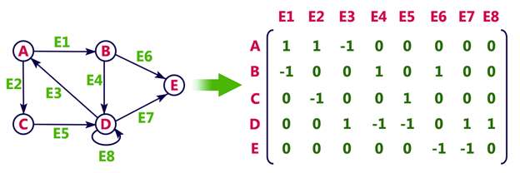
Graph representations
Incidence matrix for directed graph

Slide 65
General tree example
Trees
Example 1:
A
B
C
D
E
F
G

Slide 66
What is a tree?
Trees
Connected acyclic graph is called as tree.
Trees are structures used to represent hierarchical relationship
Each tree consists of nodes and edges
Each node represents an object
Each edge represents the relationship between two nodes.
node
edge

Slide 67
Some applications of Trees
Trees
Organization Chart
Expression Tree
President
+
VP
Personnel
VP
Marketing
*
5
3
2
Director
Customer
Relation
Director
Sales

Slide 68
Terminology I
For any two nodes u and v, if there is an edge pointing from u to v, u is called the parent of v while v is called the child of u. Such edge is denoted as (u, v).
In a tree, there is exactly one node without parent, which is called the root. The nodes without children are called leaves.
root
u
u: parent of v
v: child of u
v
leaves

Slide 69
Terminology II
In a tree, the nodes without children are called leaves. Otherwise, they are called internal nodes.
internal nodes
leaves

Slide 70
Terminology III
If two nodes have the same parent, they are siblings.
A node u is an ancestor of v if u is parent of v or parent of parent of v or …
A node v is a descendent of u if v is child of v or child of child of v or …
u
v and w are siblings
u and v are ancestors of x
v and x are descendents of u
v
w
x

Slide 71
Terminology IV
A subtree is any node together with all its descendants.
T
A subtree of T
v
v

Slide 72
Terminology V
Level of a node n: number of nodes on the path from root to node n
Height of a tree: maximum level among all of its node
Level 1
Level 2
height=4
n
Level 3
Level 4

Slide 73
Binary Tree
Binary Tree: Tree in which every node has at most 2 children
Left child of u: the child on the left of u
Right child of u: the child on the right of u
x: left child of u
y: right child of u
w: right child of v
z: left child of w
u
v
x
y
w
z

Slide 74
Full binary tree
If T is empty, T is a full binary tree of height 0.
If T is not empty and of height h >0, T is a full binary tree if both subtrees of the root of T are full binary trees of height h-1.
Full binary tree
of height 3

Slide 75
Property of binary tree (I)
A full binary tree of height h has 2^{h}-1 nodes
No. of nodes = 2⁰ + 2¹ + … + 2^{(h-1)}
= 2^{h} – 1
Level 1: 2⁰ nodes
Level 2: 2¹ nodes
Level 3: 2² nodes

Slide 76
Tree Traversal
Given a binary tree, we may like to do some operations on all nodes in a binary tree. For example, we may want to double the value in every node in a binary tree.
To do this, we need a traversal algorithm which visits every node in the binary tree.

Slide 77
Ways to traverse a tree
There are three main ways to traverse a tree:
Pre-order:
(1) visit the root node, (2) recursively visit left subtree in pre-order, (3) recursively visit right subtree in pre-order.
In-order:
(1) recursively visit left subtree in in-order, (2) visit the root node, (3) recursively visit the right subtree in in-order.
Post-order:
(1) recursively visit left subtree in post-order, (2) recursively visit right subtree in post-order, (3) visit the root node.
Level-order:
Traverse the nodes level by level
In different situations, we use different traversal algorithm.

Slide 78
Examples for expression tree
By pre-order, (prefix)
+ * 2 3 / 8 4
By in-order, (infix)
2 * 3 + 8 / 4
By post-order, (postfix)
2 3 * 8 4 / +
By level-order,
+ * / 2 3 8 4
Note 1: Infix is what we read!
Note 2: Postfix expression can be computed efficiently using stack
+
*
/
2
3
8
4

Slide 79
Trees
1. A simple graph is a tree if and only if any two distinct vertices are connected by a unique path.
2. Every connected graph contains a spanning tree.
3. The number of edges in a tree on n vertices is n-1. Conversely, a connected graph on n vertices and n-1 edges
is a tree.
4. A tree with at least two vertices contains at least two pendant vertices (i.e., end vertices or vertices of degree 1).
5. A connected graph G is a tree if and only if every edge of G is a cut edge of G.
6. A connected graph G with at least two vertices is a tree if and only if its degree sequence{d1,d2,…,dn} satisﬁes the condition: ∑_{i=1} ^{n} d_{i}=2(n-1) with d_{i} >0 for each i.
7.If u and v are non adjacent vertices of a tree T, then T+ uv contains a unique cycle.
8. Every tree has a center consisting of either a single vertex or two adjacent vertices.

Slide 80
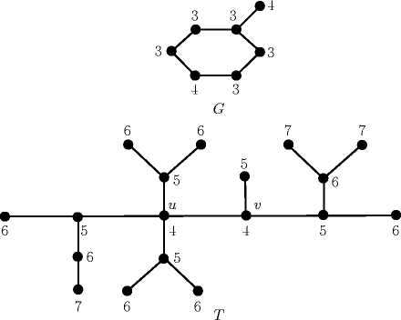
Trees
Deﬁnitions: Let G be a connected graph.
1. The diameter of G is deﬁned as max{d(u,v) : u,v Ɛ V(G) and is denoted by diam(G).
2. If v is a vertex of G, its eccentricity e(v) is deﬁned by e(v)= max {d(v, u) : u Ɛ V(G).
3. The radius r(G) of G is the minimum eccentricity of G: that is, r(G)= min{e(v) : v Ɛ V(G).
4. A vertex v of G is called a central vertex if e(v)= r(G). The set of central vertices of G is called the center of G.

Slide 81
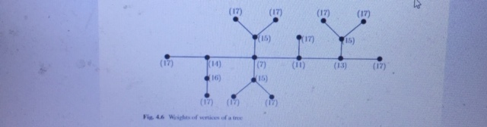
Trees
1. A branch at a vertex u of a tree T is a maximal sub tree containing u as an end vertex. Hence the number of branches
at u is deg(u).
2. The weight of a vertex u of T is the maximum number of edges in any branch at u.
3. A vertex v is a centroid vertex of T if v has minimum weight.
The set of all centroid vertices is called the centroid of T .

Slide 82
Counting the Number of Spanning Trees
Counting the number of spanning trees in a graph occurs as a natural problem in many branches of science. Spanning trees were used by Kirchoff to generate a“cycle basis” for the cycles in the graphs of electrical networks.
The number of spanning trees of a connected labeled graph G will be denoted by Ʈ(G). If G is disconnected, we take
Ʈ(G)=0.
There is a recursive formula for (G). Before establish this formula, let us deﬁne the concept of edge contraction in graphs.
Deﬁnition: An edge e of a graph G is said to be contracted if it is deleted from G and its ends are identiﬁed. The resulting graph is denoted by G o e. Edge contraction is illustrated in Fig. below. If e is not a loop of G, then n(G o e)= n(G)-1,
m(G o e)= m(G)-1.
If e is not a loop of a connected graph G, Ʈ(G)= Ʈ(G-e) + Ʈ(G o e).

Slide 83
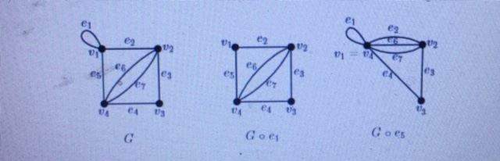
Counting the Number of Spanning Trees

Slide 84
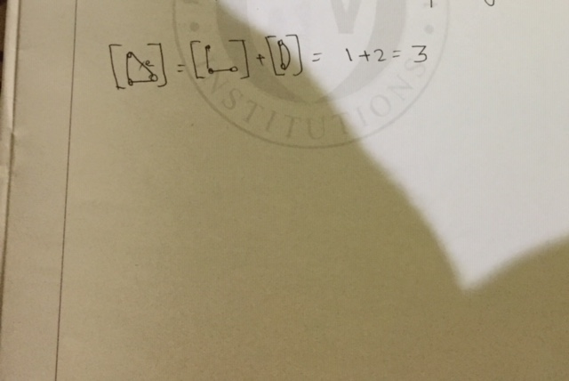
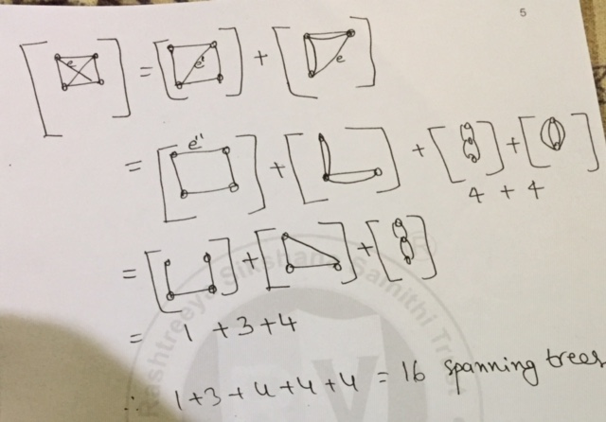
Counting the Number of Spanning Trees
Example 1: How many spanning trees are there for K₃?
Example 2: How many spanning trees are there for K₄?

Slide 85
How many spanning trees does the K₃ have?

Slide 86
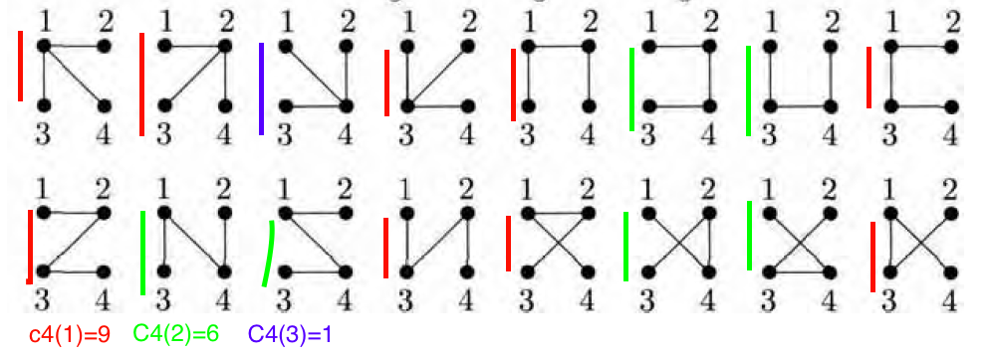

Slide 87
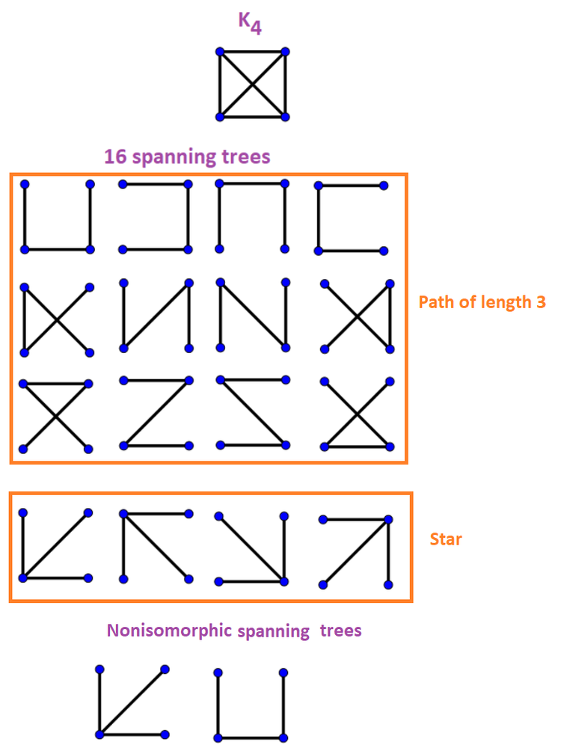

Slide 88
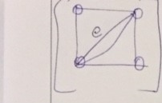
Counting the Number of Spanning Trees
Example 3: How many spanning trees are there for the graph G below?

Slide 89
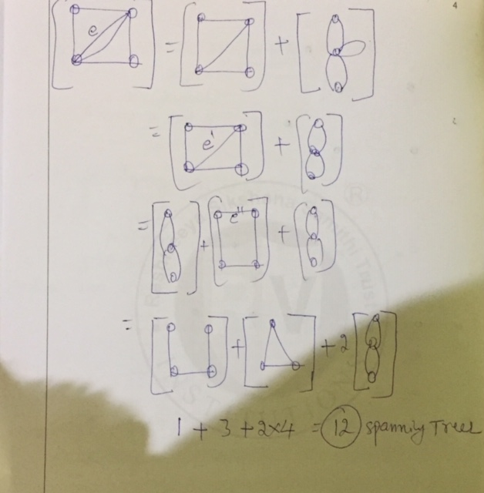
Counting the Number of Spanning Trees

Slide 90
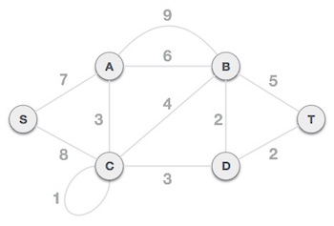
Minimum Cost Spanning Trees
Kruskal's algorithm to find the minimum cost spanning tree uses the greedy approach.
This algorithm treats the graph as a forest and every node it has as an individual tree. A tree connects to another only and only if, it has the least cost among all available options and does not violate MST properties.
To understand Kruskal's algorithm let us consider the following example −

Slide 91
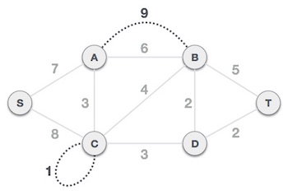
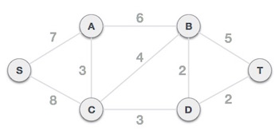
Minimum Cost Spanning Trees
Step 1 - Remove all loops and Parallel Edges Remove all loops and parallel edges from the given graph.
In case of parallel edges, keep the one which has the least cost associated and remove all others.

Slide 92

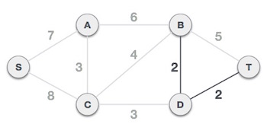
Minimum Cost Spanning Trees
Step 2 - Arrange all edges in their increasing order of weight
The next step is to create a set of edges and weight, and arrange them in an ascending order of weightage (cost).
Step 3 - Add the edge which has the least weightage
Now we start adding edges to the graph beginning from the one which has the least weight. Throughout, we shall keep checking that the spanning properties remain intact. In case, by adding one edge, the spanning tree property does not hold then we shall consider not to include the edge in the graph.

Slide 93
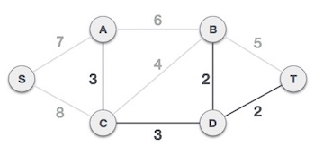
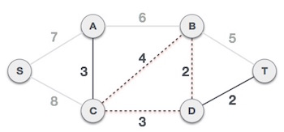
Minimum Cost Spanning Trees
The least cost is 2 and edges involved are B,D and D,T. We add them. Adding them does not violate spanning tree properties, so we continue to our next edge selection.
Next cost is 3, and associated edges are A,C and C,D. We add them again −
Next cost in the table is 4, and we observe that adding it will create a circuit in the graph. −

Slide 94
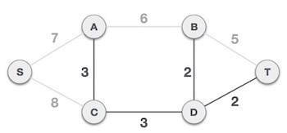
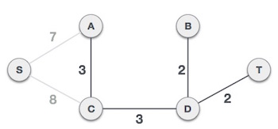
Minimum Cost Spanning Trees
We observe that edges with cost 5 and 6 also create circuits. We ignore them and move on.
We ignore it. In the process we shall ignore/avoid all edges that create a circuit.

Slide 95
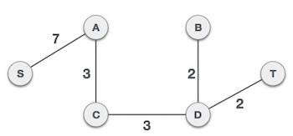
Minimum Cost Spanning Trees
By adding edge S,A we have included all the nodes of the graph and we now have minimum cost spanning tree.
Now we are left with only one node to be added. Between the two least cost edges available 7 and 8, we shall add the edge with cost 7.

Slide 96
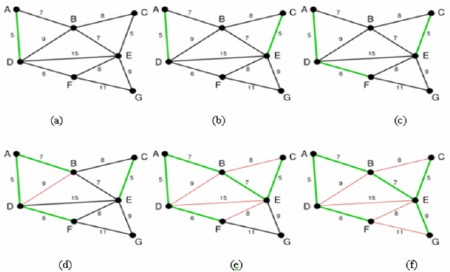
Minimum Cost Spanning Trees

Slide 97
Minimum Cost Spanning Trees
Prim's algorithm to find minimum cost spanning tree (as Kruskal's algorithm) uses the greedy approach. Prim's algorithm shares a similarity with the shortest path first algorithms.
Prim's algorithm, in contrast with Kruskal's algorithm, treats the nodes as a single tree and keeps on adding new nodes to the spanning tree from the given graph.
To contrast with Kruskal's algorithm and to understand Prim's algorithm better, we shall use the same example −

Slide 98
Minimum Cost Spanning Trees
Step 1 - Remove all loops and parallel edges
Remove all loops and parallel edges from the given graph. In case of parallel edges, keep the one which has the least cost associated and remove all others.

Slide 99
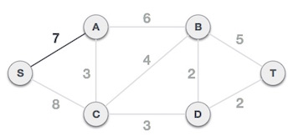
Minimum Cost Spanning Trees
Step 2 - Choose any arbitrary node as root node
In this case, we choose S node as the root node of Prim's spanning tree. This node is arbitrarily chosen, so any node can be the root node. One may wonder why any video can be a root node. So the answer is, in the spanning tree all the nodes of a graph are included and because it is connected then there must be at least one edge, which will join it to the rest of the tree.
Step 3 - Check outgoing edges and select the one with less cost
Now, the tree S-7-A is treated as one node and we check for all edges going out from it. We select the one which has the lowest cost and include it in the tree.

Slide 100
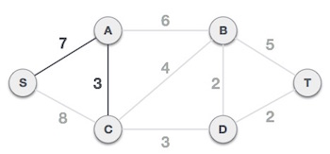
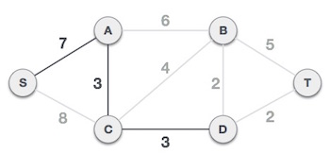
Minimum Cost Spanning Trees
After this step, S-7-A-3-C tree is formed. Now we'll again treat it as a node and will check all the edges again. However, we will choose only the least cost edge. In this case, C-3-D is the new edge, which is less than other edges' cost 8, 6, 4, etc.

Slide 101
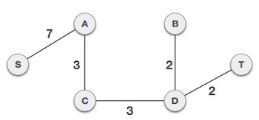
Minimum Cost Spanning Trees
After adding node D to the spanning tree, we now have two edges going out of it having the same cost, i.e. D-2-T and D-2-B. Thus, we can add either one. But the next step will again yield edge 2 as the least cost. Hence, we are showing a spanning tree with both edges included.
We may find that the output spanning tree of the same graph using two different algorithms is same.

Slide 102
Euler Trails and Circuits
Eulerian and Hamiltonian Graphs
The Seven bridges of Königsberg
C
c
D
A
a
d
B
b

Slide 103
Eulerian and Hamiltonian Graphs
An Euler trail is a path using every edge of the graph G exactly once.
An Euler circuit is an Euler path that returns to its start.
C
Does this graph have an Euler circuit?
A
D
No.
B

Slide 104
Eulerian and Hamiltonian Graphs
Necessary and Sufficient Conditions
How about multigraphs?
A connected multigraph has a Euler circuit iff each of its vertices has an even degree.
A connected multigraph has a Euler path but not an Euler circuit iff it has exactly two vertices of odd degree.

Slide 105
Example
Which of the following graphs has an Euler circuit?
a
b
a
b
a
b
e
e
d
c
d
c
c
d
e
yes no no
(a, e, c, d, e, b, a)

Slide 106
Example
Which of the following graphs has an Euler trail?
a
b
a
b
a
b
e
e
d
c
d
c
c
d
e
yes no yes
(a, e, c, d, e, b, a ) (a, c, d, e, b, d, a, b)

Slide 107
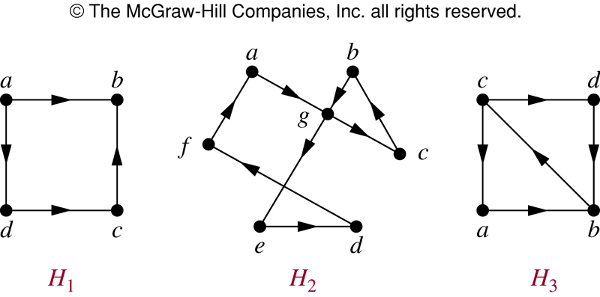
Euler Circuit in Directed Graphs
NO (a, g, c, b, g, e, d, f, a) NO

Slide 108
Euler Path in Directed Graphs
NO (a, g, c, b, g, e, d, f, a) (c, a, b, c, d, b)

Slide 109
Hamilton Paths and Cycles
A Hamilton path in a graph G is a path which visits every vertex in G exactly once.
A Hamilton cycle is a Hamilton path that returns to its start.

Slide 110

Hamilton Circuits
Dodecahedron puzzle and it equivalent graph
Is there a cycle in this graph that passes through each vertex exactly once?

Slide 111

Hamilton Circuits
Yes; this has a cycle that passes through each vertex exactly once.

Slide 112

Finding Hamilton Circuits
Which of these three figures has a Hamilton cycle? Of, if no Hamilton cycle, a Hamilton path?

Slide 113
Finding Hamilton Circuits
G₁ has a Hamilton cycle: a, b, c, d, e, a
G₂ does not have a Hamilton cycle, but does have a Hamilton path: a, b, c, d
G₃ has neither.

Slide 114
Finding Hamilton Circuits
Unlike the Euler circuit problem, finding Hamilton cycle is hard.
There is no simple set of necessary and sufficient conditions, and no simple algorithm.

Slide 115
Properties to look for ...
No vertex of degree 1
If a node has degree 2, then both edges incident to it must be in any Hamilton cycle.
No smaller cycles contained in any Hamilton cycle (the start/endpoint of any smaller circuit would have to be visited twice).

Slide 116
A Sufficient Condition
Let G be a connected simple graph with n vertices with n ≥ 3.
If the degree of each vertex is ≥ n/2,
then G has a Hamilton cycle.

Slide 117
Properties of Planar Graphs
Definition:
A graph that can be drawn in the plane without any of its edges intersecting is called a planar graph. A graph that is so drawn in the plane is also said to be embedded in the plane.
Applications: circuit layout problems

Slide 118
Definition:
A planar graph G that is drawn in the plane so that no two edges intersect (that is, G is embedded in the plane) is called a plane graph.
(a) planar, not a plane graph
(c) another plane graph
(b) a plane graph

Slide 119
Note. A given planar graph can give rise to several different plane graph.
Definition:
Let G be a plane graph. The connected pieces of the plane that remain when the vertices and edges of G are removed are called the regions of G.
G₁
R₃: exterior
R₁
R₂
G₁ has 3 regions.

Slide 120
Definition:
Every plane graph has exactly one unbounded region, called the exterior region. The vertices and edges of G that are incident with a region R form a sub graph of G called the boundary of R.
G₂
G₂ has only 1 region.

Slide 121
Fig 2
Boundary of R₁:
v₁
v₂
G₃
v₁
v₂
R₁
v₃
v₃
Boundary of R₅:
v₅
R₅
v₁
v₂
v₄
v₆
v₇
R₂
v₃
v₅
R₃
v₄
v₈
v₉
R₄
v₆
v₇
G₃ has 5 regions.
v₉

Slide 122
Observe: (1) Each cycle edge belongs to the boundary of two regions.
(2) Each bridge is on the boundary of only one region.
(exterior)

Slide 123
Thm 1: (Euler’s Formula)
If G is a connected plane graph with p vertices, q edges, and r regions, then p − q + r = 2.
pf: (by induction on q)
(basis) If q = 0, then G ≅ K₁; so p = 1, r =1, and p − q + r = 2.
(inductive) Assume the result is true for any graph with q = k − 1 edges, where k ≥ 1.
Let G be a graph with k edges. Suppose G has p vertices and r regions.

Slide 124
If G is a tree, then G has p vertices, p−1 edges and 1 region.
⇒ p − q + r = p – (p−1) + 1 = 2.
If G is not a tree, then some edge e of G is on a cycle.
Hence G−e is a connected plane graph having order p and size k−1, and r−1 regions.
⇒ p − (k−1) + (r−1) = 2 (by assumption)
⇒ p − k + r = 2
#

Slide 125
Theorem : Euler’s Formula
If G is a connected planar graph, then any plane graph depiction of G has r = e - v + 2 regions.
Recall: Connected planar graphs have paths between each pair of vertices.
v = number of vertices
e = number of edges
r = number of regions
This is important because there are many different plane graph depictions that can be drawn for a planar graph, however, the number of regions will not change.

Slide 126
Proof of Euler’s Formula
Let’s draw a plane graph depiction of G, edge by edge.
Let denote the connected plane graph after n edges have been added.
Let denote the number of vertices in
Let denote the number of edges in
Let denote the number of regions in

Slide 127
Proof of Euler’s Formula (cont’d)
Let’s start by drawing
Euler’s formula is valid for , since
r=e-v+2
1=1-2+2
We obtain by adding an edge at one of from the vertices of .

Slide 128
Proof of Euler’s Formula (cont’d)
In general, we can obtain from by adding an edge to one of the vertices of .
The new edge might link two vertices already in .
Or, the new edge might add another vertex to .
We will use the method of induction to complete the proof:
We have shown that the theorem is true for .
Next, let’s assume that it is true for for any n>1, and prove it is true for .
Let (x,y) be the edge that is added to to get .
There are two cases to consider.

Slide 129
Proof of Euler’s Formula (cont’d)
In the first case, x and y are both in .
Then they are on the boundary of a common region K , possibly an unbounded region.
Edge (x, y) splits K into two regions.
Then,
Each side of Euler’s formula grows by one.
So, if the formula was true for , it will also be true for .
y
K
x

Slide 130
Proof of Euler’s Formula (cont’d)
In the second case, one of the vertices x,y is not in . Let’s say that it is x.
Then, adding (x,y) implies that x is also added, but that no new regions are formed (no existing regions are split).
So, the value on each side of Euler’s equation is unchanged.
The validity of Euler’s formula for implies its validity for .
By induction, Euler’s formula is true for all ’s and the full graph G.
x
y
K

Slide 131
Example of Euler’s Formula
How many regions would there be in a plane graph with 10 vertices each of degree 3?

Slide 132
Corollary
If G is a connected planar graph with e > 1, then e ≤ 3v – 6
Proof:
Define the degree of a region as the number of edges on its boundary. If an edge occurs twice along the boundary, then count it twice. The region K has degree 12.
K

Slide 133
Proof of Corollary continued
Note that no region can be less than degree 3.
A region of degree 2 would be bounded by two edges joining the same pair of vertices (parallel edges)
A region of degree 1 would be bounded by a loop edge.
Neither of these is allowed, and so a region must have at least degree 3.

Slide 134
Proof of Corollary continued

Slide 135
Fig 4 Two embeddings of a planar graph
(a)
(b)

Slide 136
Definition:
A plane graph G is called maximal planar if, for every pair u, v of nonadjacent vertices of G, the graph G+uv is nonplanar.
Thus, in any embedding of a maximal planar graph G of order at least 3, the boundary of every region of G is a triangle.

Slide 137
Thm 2: If G is a maximal planar graph with p ≥ 3 vertices and q edges, then q = 3p − 6.
pf:
Embed the graph G in the plane, resulting in r regions.
⇒ p − q + r = 2.
Since the boundary of every region of G is a triangle, every edge lies on the boundary of two regions.
⇒
⇒ p − q + 2q / 3 = 2.
⇒ q = 3p − 6

Slide 138
Cor. 2(a): If G is a maximal planar bipartite graph with p ≥ 3 vertices and q edges, then q = 2p − 4.
The boundary of every region is a 4-cycle.
4r = 2q ⇒ p − q + q / 2 = 2 ⇒ q = 2p − 4.
If G is not maximal planar, we can add edges to G to produce a maximal planar graph.

Slide 139
Fig 5 Two important nonplanar graph
K_{3,3}
K₅

Slide 140
Definition:
A subdivision of a graph G is a graph obtained by inserting vertices (of degree 2) into the edges of G.

Slide 141
Subdivisions of graphs.
H
G
H is a subdivision of G.
F
F is not a subdivision of G.

Slide 142
Thm 5: (Kuratowski’s Theorem) A graph is planar if and only if it contains no subgraph that is isomorphic to or is a subdivision of K₅ or K_{3,3}.
Fig 7 The Petersen graph is nonplanar.
1
2
3
1
4
5
6
10
7
4
5
6
2
3
8
9
(a) Petersen
(b) Subdivision of K_{3,3}

Slide 143

Dual of a planar graph
Example: 1

Slide 144

Dual of a planar graph
Example: 2

Slide 145
Graph Coloring
Vertex Colorings
Applications of Graph Coloring
Let us begin with a practical application of graph coloring known as the storage problem. Suppose a university’s Department of Chemistry wants to store its chemicals. It is quite probable that some chemicals cause violent reactions when brought together. Such chemicals are incompatible chemicals. For safe storage, incompatible chemicals should be kept in distinct rooms.
The easiest way to accomplish this is, of course, to store one chemical in each room. But this is certainly not the best way of doing it since we will be using more rooms than are really needed (unless, of course, all the chemicals are mutually incompatible!).

Slide 146
Graph Coloring
So we ask: What is the minimum number of rooms required to store all the chemicals so that in each room only compatible chemicals are stored?
We convert the above storage problem into a problem in graphs. Form a graph G=(V, E) by making V correspond bijectively to the set of available chemicals and making u adjacent to v if and only if the chemicals corresponding to u and v are incompatible. Then, any set of compatible chemicals correspond to a set of independent vertices of G: Thus, a safe storing of chemicals corresponds to a partition of V into independent subsets of G: The cardinality of such a minimum partition of V is then the required number of rooms. The minimum cardinality is called the chromatic number of the graph G.

Slide 147
Graph Coloring
Definition 1: The chromatic number of a graph G is the minimum number of colors needed for a proper vertex coloring of G. G is k-chromatic if χ(G)= k.
Definition 2: A k-coloring of a graph G is a vertex coloring of G that uses at most k colors.
Definition 3: A graph G is said to be k-colorable if G admits a proper vertex coloring using at most k colors.

Slide 148
Graph Coloring
In considering the chromatic number of a graph, only the adjacency of vertices is taken into account. Hence, multiple edges and loops may be discarded while considering chromatic numbers, unless needed otherwise. As a consequence, we may restrict ourselves to simple graphs when dealing with (vertex) chromatic numbers.
It is clear that χ(Kn)= n:
Further, χ(G)= 2 if and only if G is bipartite having at least one edge.
In particular, χ(T)= 2 for any tree T with at least one edge (since any tree is bipartite).
Further χ(Cn)=( 2 if n is even or 3 if n is odd.

Slide 149

Graph Coloring
Exercise 1: Determine the chromatic number of
i. The Petersen graph
Ii, Wheel Wn

Slide 150
Graph Coloring
Edge Colorings of Graphs
The Timetable Problem:
Suppose in a school there are r teachers, T1,T2,…………,Tr, and s classes, C1,C2,………..,Cs. Each teacher Ti is expected to teach the class Cj for pij periods. It is clear that during any particular period, no more than one teacher can handle a particular class and no more than one class can be engaged by any teacher. Our aim is to draw up a timetable for the day that requires only the minimum number of periods. This problem is known as the “timetable problem.”

Slide 151
Graph Coloring
To convert this problem into a graph-theoretic one, we form the bipartite graph G= G(T, C) with bipartition (T, C), where T represents the set of teachers Ti and C represents the set of classes Cj : Further, Ti is made adjacent to Cj in G with pij parallel edges if and only if teacher Ti is to handle class Cj for pij periods.
Now color the edges of G so that no two adjacent edges receive the same color. Then the edges in a particular color class, that is, the edges in that color, form a matching in G and correspond to a schedule of work for a particular period. Hence, the minimum number of periods required is the minimum number of colors in an edge coloring of G in which adjacent edges receive distinct colors, in other words, it is the edgechromatic number of G.

Slide 152
Graph Coloring
Definition 4: An edge coloring of a loopless graph G is a function ∏:E(G)→ S; where S is a set of distinct colors; it is proper if no two adjacent edges receive the same color.
Definition 5: The minimum k for which a loop less graph G has a proper k-edge coloring is called the edge-chromatic number or chromatic index of G: It is denoted by χ’(.G).
G is k-edge-chromatic if χ’(.G)=k.

Slide 153
Graph Coloring
Example: i) If G is bipartite graph, then χ’(G)=?
// χ’(G)=Δ(G)
ii) If G is Kn, then χ’(G)=?
// χ’ (Kn)= n-1 if n is even
// χ’(Kn)=n if n is odd.

Slide 154
Graph Coloring
Chromatic Polynomials
For a graph G and a given set of λ colors, the function f(G, λ) is defined to be the number of ways of (vertex) coloring G properly using the λ colors. Hence, f(G, λ)= 0 when G has no proper λ -coloring. Clearly, the minimum for which f(G, λ) > 0 is the chromatic number χ (G) of G.
It is easy to see that f(Kn)=λ(λ-1)(λ-2)……(λ-n+1) for λ≥ n.
This is because any vertex of Kn can be colored by any one of the given λ colors.
After coloring a vertex of Kn, a second vertex of Kn can be colored by any one of the remaining ( λ- 1) colors, and so on. In particular, f(K3, λ)=λ(λ-1)(λ-2).

Slide 155
Graph Coloring
What is f(Cn, λ)=?
f(C4, λ)=?
How to find the chromatic polynomial for a graph G in general?
// Use decomposition theorem
Theorem : Let G be any graph. Then f(G, λ)= f(G-e, λ) – f(Goe, λ) for any edge e of G.

Slide 156
Graph Coloring
Proof: f(G-e, λ) denotes the number of proper colorings of G-e using λ colors. Hence, it is the sum of the number of proper colorings of G-e in which u and v receive the same color and the number of proper colorings of G-e in which u and v receive distinct colors. The former number is f(Goe, λ), and the latter number is f(G, λ)
If G and H are disjoint graphs, then f(G U H, λ)= f(G, λ)f(H, λ).

Slide 157

Graph Coloring

Slide 158

Graph Coloring

